Slide 1
Signature Detection

Slide 2
Presentation Outline
Introduction
Why Need Signature Detection?
Block Diagram
Steps To Work
Graphical User Interface
Conclusion
Future Works

Slide 3
Introduction:
A signature is a person’s name written in a particular way as a form of identification in authorizing a check or document or conducting a letter.
Signature detection can be performed either Offline or Online based on the application.
Online systems use dynamic information of a signature captured at the time the signature is made.
Offline systems work on the scanned image of a signature.

Slide 4
Why Need Signature Detection?
Signature is an important aspect for authentication of an individual.
Traditional bank checks, bank credits, credit cards and different authoritative archives are an integral part of the modern economy.
They are one of the essential mediums by which people and associations transfer money and pay bills.
Even today all these transactions especially financial require our signatures to be authenticated.

Slide 5
Block Diagram
Signature Obtained
Signature Preprocessing
Characteristics Extraction
Signature Processing
Signature Detection

Slide 6

Steps To Work
Signatures was taken in white paper and scanned for training system.
Similarly forged and genuine version of signatures were taken for testing the performance.
Figure: A sample signature to be processed

Slide 7
Steps To Work
Dataset:
Users | Signature Number
Atika | 5
Fatin | 5
Quick | 5
Fox | 5
Saju | 5

Slide 8

Steps To Work
Signature preprocessing is an important step to improve the exactness of the latter algorithm, and to reduce their computational needs.
Following preprocessing steps are thought about:
Transformation from color to grayscale.
Transformation from grayscale to black and white using suitable threshold.
Color Inversion:-The true color image RGB is converted to the grayscale intensity image by eliminating the hue and saturation information while retaining the luminance.
Apply opening and shutting morphological procedures with little structure component to remove the inward and external noise.
Figure: A Grayscale Intensity Image

Slide 9
Steps To Work
Characteristics extraction is the key to develop an offline signature recognition system.
We use a set of five global characteristics that cannot be affected by the temporal shift.
Area: Actual number of pixels in the region.
Centroid: Horizontal and vertical centers of gravity of the signature.
Eccentricity: The ratio of the distance between the foci of the ellipse and its major axis length.
Kurtosis: It is a measure of flatness of distribution.
Skewness: It is a measure of asymmetry of distribution.

Slide 10
Steps To Work
Signature Processing
Original grayscale Fingerprint Image
Filtering and Noise Reduction
Binarization and Thinning
Enhanced Binary Image
Post Processing and Filtering

Slide 11

Figure: A Binary Image

Slide 12
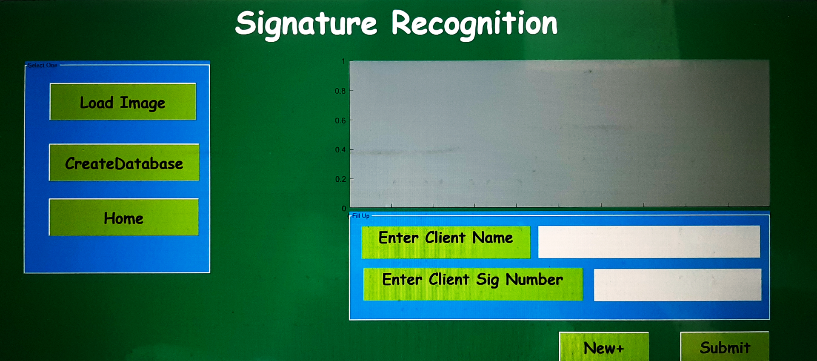
Graphical User Interface
Figure: Simple Graphical User Interface

Slide 13
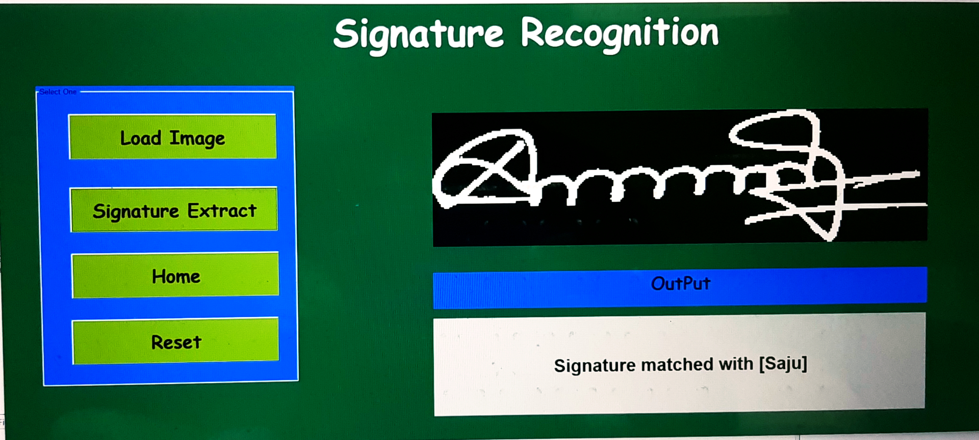
Figure: Signature Verification

Slide 14
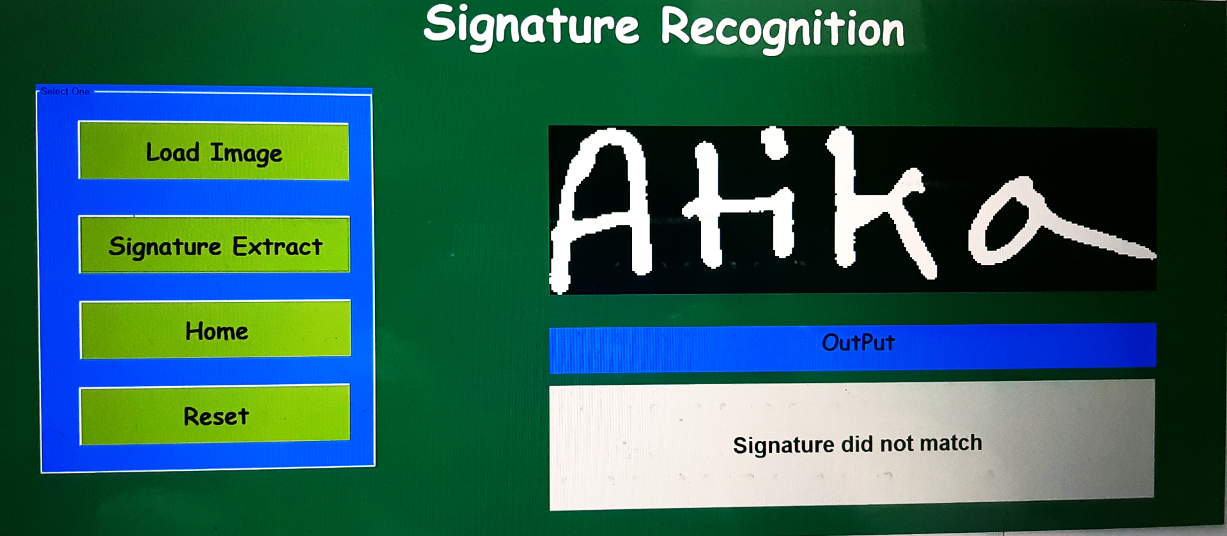
Figure: Signature Verification

Slide 15
Conclusion
The algorithm we supported uses simple geometric features to characterize signatures that effectively serve to classify signature as exact or forged.
The system is robust and can detect random, simple and semi-skilled forgeries.

Slide 16
Future Work
We can improve the work to check on-line signature which could be more precise or solid framework.
And we could manufacture an android application that could likewise some other biometric confirmation framework like handwriting examination when joined with other biometric angles.
For example, discourse and face acknowledgment can introduce a far superior outcome than any individual framework.

Slide 17
Thank you! & Questions?

